Slide 1
From Vision to Reality: The Power of Documenting Software Architecture Decisions
Images from: unsplash.com

Slide 2

Who am I?
Jose (Cheche) Calderon
Lead Software Engineer
☕
🏃‍♂️
🥁
🇻🇪
=
❤️
#GDG #UofG
Notes:
Photo by <a href="https://unsplash.com/@helloimnik?utm_source=unsplash&utm_medium=referral&utm_content=creditCopyText">Hello I'm Nik</a> on <a href="https://unsplash.com/s/photos/lego-programmer?utm_source=unsplash&utm_medium=referral&utm_content=creditCopyText">Unsplash</a>

Slide 3
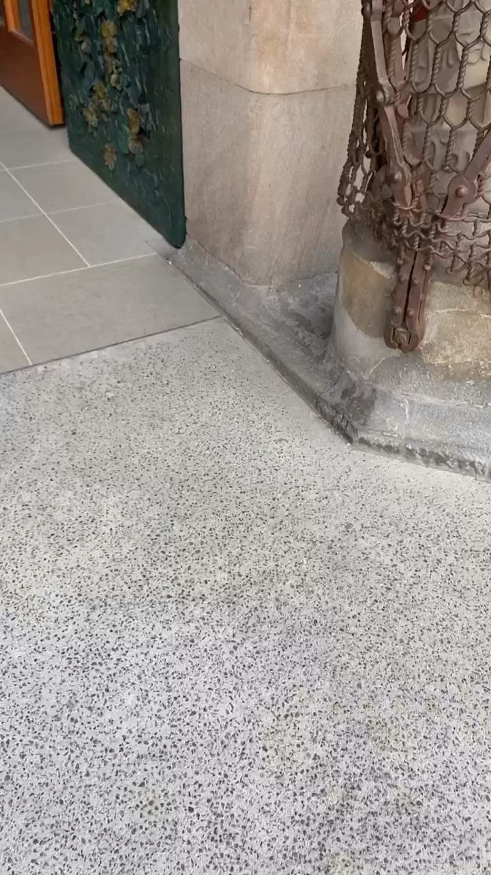
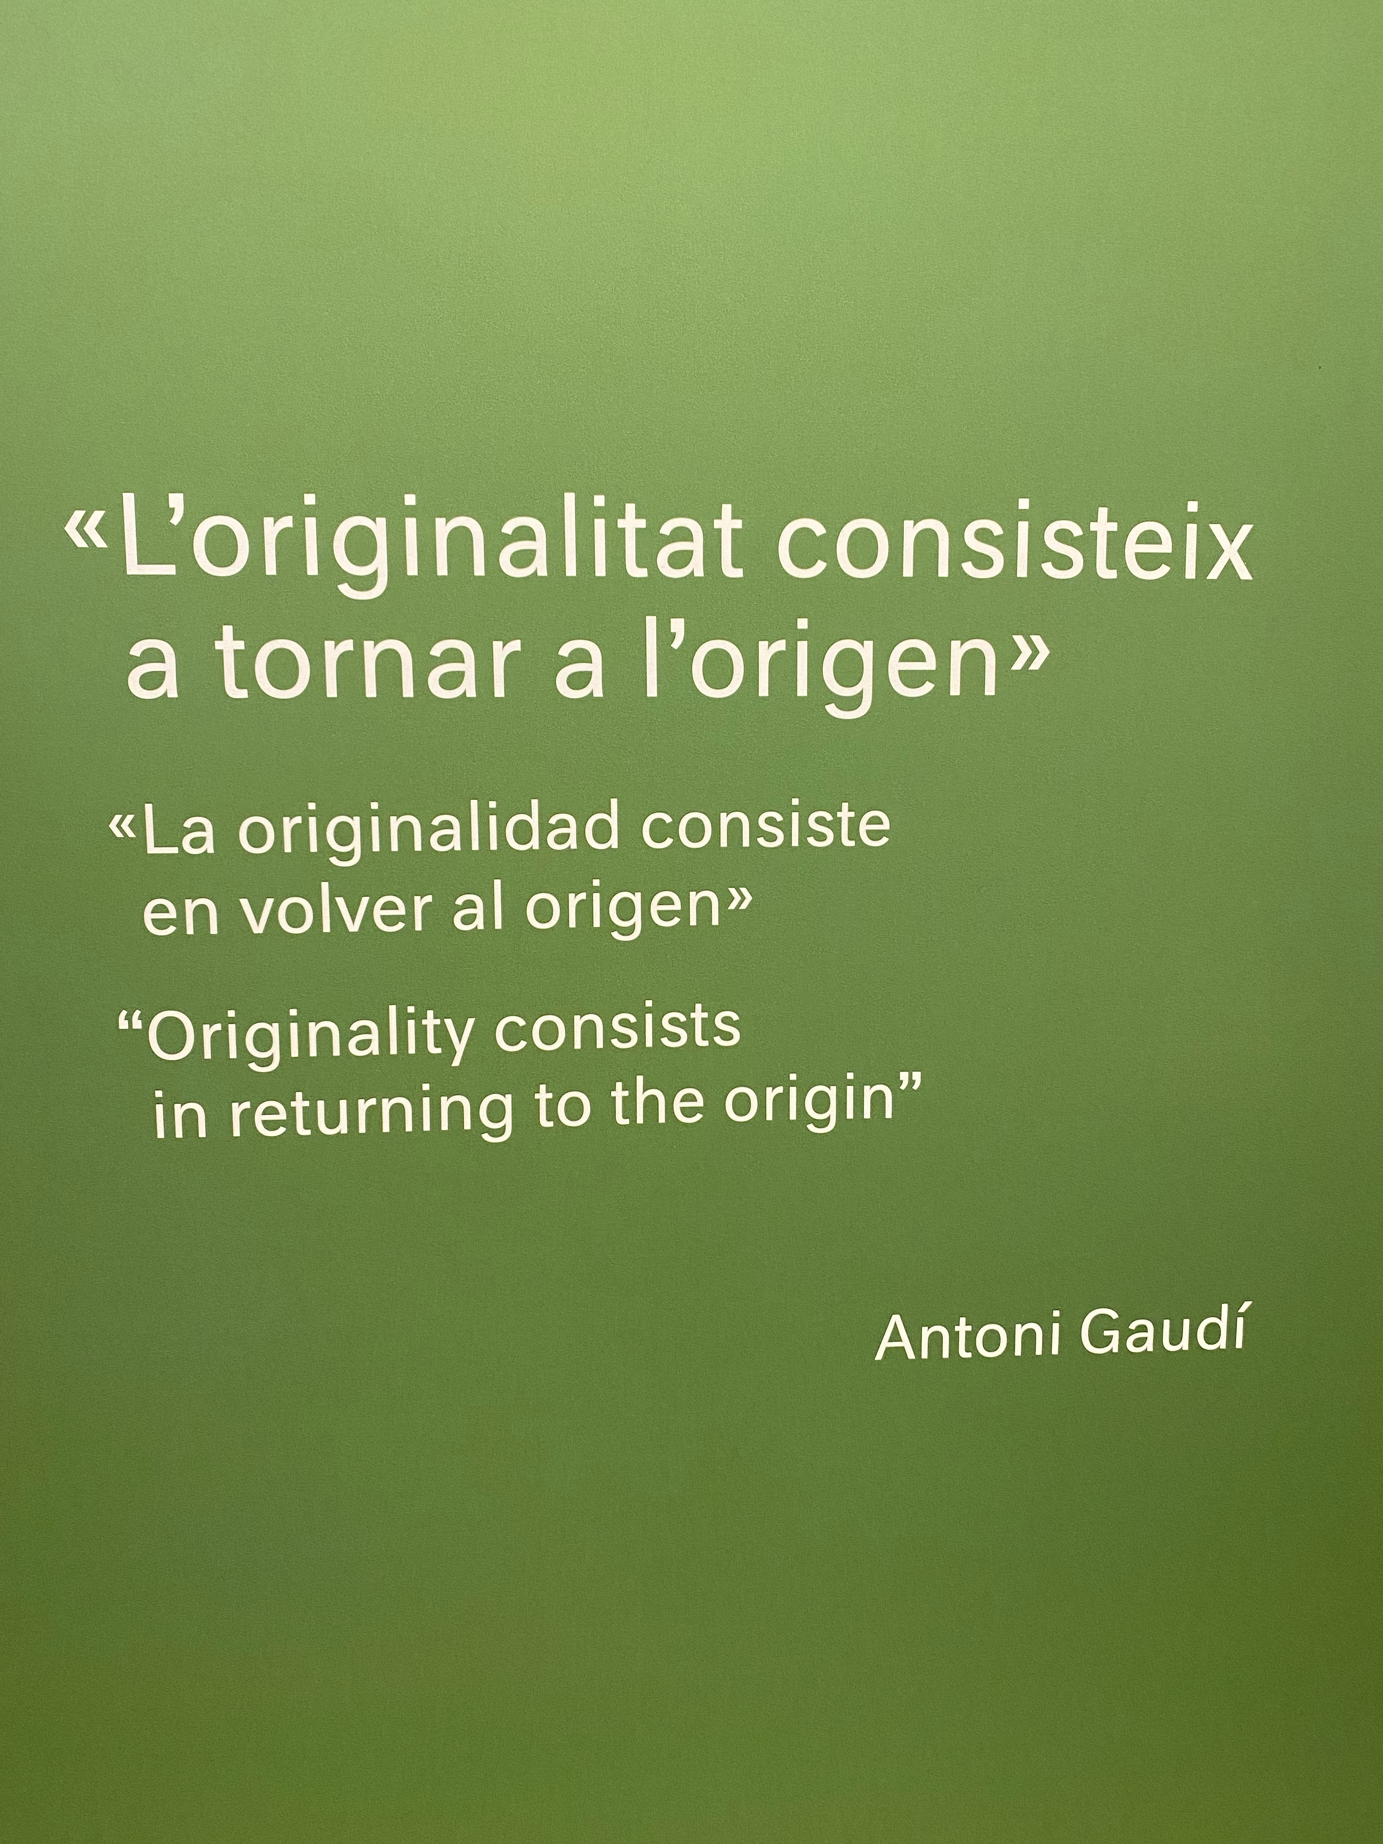
Notes:
Why is Documentation important?
La Sagrada Familia… One of the most beautiful buildings I have ever see.

Slide 4
SAGRADA FAMILIA TIME LINE
1882
2023
Notes:
From the first stone to what we can see today is more than 140 years…
From Vision to realisation over 100 years

